Slide 1
GE-161 Discrete Structures
Unit 6: Number Theory
Dr. Asif Sohail University of the Punjab Department of Information Technology, FCIT
Some of the slides are adapted from Fahad Hussain
https://fahadhussaincs.blogspot.com/

Slide 2
Division
When one integer is divided by a second nonzero integer, the quotient may or may not be an integer. For example, 12 ∕ 3 = 4 , 11∕4 = 2.75
If a and b are integers with a ≠ 0, we say that a divides b if there is an integer c such that b = ac (or equivalently, if b/a is an integer).
When a divides b we say that a is a factor or divisor of b, and that b is a multiple of a The notation a ∣ b denotes that a divides b.
Remark: We can express a ∣ b using quantifiers as ∃c(ac = b), where the universe of discourse is the set of integers.
Example: True/False: 3 ∣ 7, 3 ∣ 12
Question: Let n and d be positive integers. How many positive integers not exceeding n are divisible by d?
Solution: The positive integers divisible by d are all the integers of the form dk, where k is a positive integer. Hence, the number of positive integers divisible by d that do not exceed n equals the number of integers k with 0 < dk ≤ n, or with 0 < k ≤ n∕d. Therefore, there are ⌊n∕d⌋ positive integers not exceeding n that are divisible by d.

Slide 3
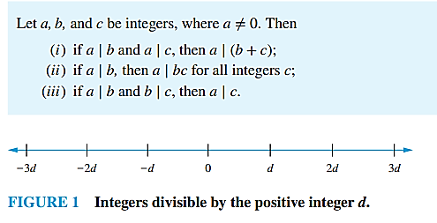
THEOREM 1

Slide 4
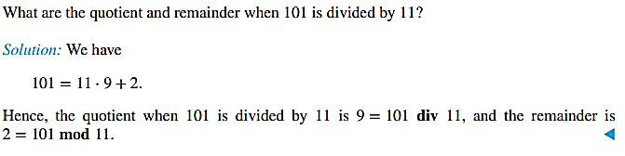
The Division Algorithm
Let a be an integer and d a positive integer. Then there are unique integers q and r, with 0 ≤ r < d, such that a = dq + r.
d is called the divisor, a is called the dividend, q is called the quotient, and r is called the remainder. This notation is used to express the quotient and remainder: q = a div d, r = a mod d.
What are the quotient and remainder when −11 is divided by 3?

Slide 5
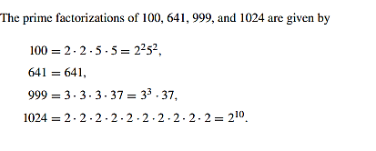
Primes
An integer p greater than 1 is called prime if the only positive factors of p are 1 and p.
A positive integer that is greater than 1 and is not prime is called composite. The integer n is composite if and only if there exists an integer a such that a | n and 1 <a<n.
THE FUNDAMENTAL THEOREM OF ARITHMETIC
Every integer greater than 1 can be written uniquely as a prime or as the product of two or more primes where the prime factors are written in order of nondecreasing size.

Slide 6
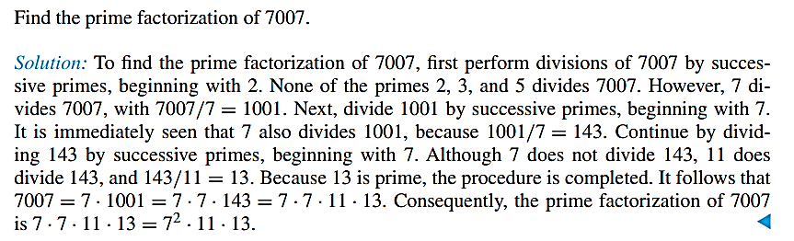
Primes
If n is a composite integer, then n has a prime divisor less than or equal to √n.
Show that 101 is prime.
Solution: The only primes not exceeding √101 are 2, 3, 5, and 7. Because 101 is not divisible by 2, 3, 5, or 7 (the quotient of 101 and each of these integers is not an integer), it follows that 101 is prime.

Slide 7
Greatest Common Divisors
Let a and b be integers, not both zero. The largest integer d such that d| a and also d| b is called the greatest common divisor of a and b written as gcd(a,b).
Example: gcd(24,36) = 12
The integers a and b are relatively prime if their gcd is 1. (17 and 22)
The integers a₁, a₂, …, a_{n} are pairwise relatively prime if gcd(a_{i}, a_{j})= 1 whenever 1 ≤ i<j ≤n.
Example: Determine whether the integers 10, 17 and 21 are pairwise relatively prime.
Solution: Because gcd(10,17) = 1, gcd(10,21) = 1, and gcd(17,21) = 1, 10, 17, and 21 are pairwise relatively prime.
Are the integers 10, 19, and 24 pairwise relatively prime.

Slide 8
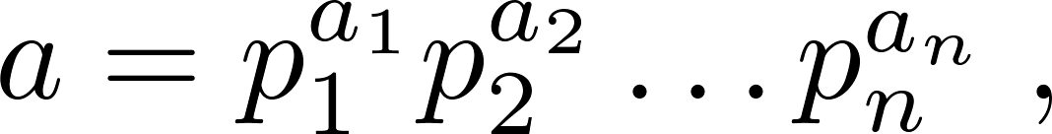
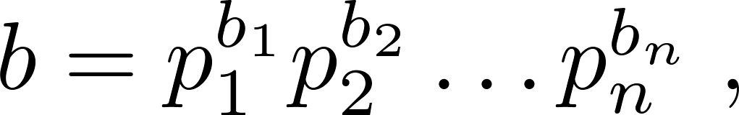
Greatest Common Divisor
Suppose the prime factorizations of a and b are:
where each exponent is a nonnegative integer, and where all primes occurring in either prime factorization are included in both. Then:
This formula is valid since the integer on the right (of the equals sign) divides both a and b. No larger integer can divide both a and b.
Example: 120 = 2³ ∙3 ∙5 500 = 2² ∙5³
gcd(120,500) = 2^{min(3,2)} ∙3^{min(1,0)} ∙5^{min(1,3)} = 2² ∙3⁰ ∙5¹ = 20

Slide 9
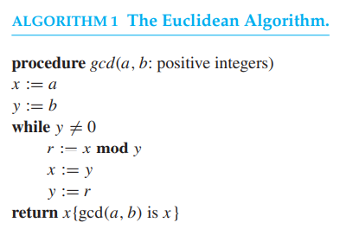
Greatest Common Divisors
Computing the greatest common divisor of two integers using prime factorizations is inefficient.
An ancient Greek mathematician Euclid proposed an efficient method of finding the greatest common divisor called Euclidean algorithm..
Find gcd(91,287)

Slide 10
gcd as Linear Combinations (BÉZOUT’S THEOREM)
If a and b are positive integers, then integers s and t such that gcd(a, b) = sa + tb are called Bézout coefficients of a and b (after Étienne Bézout, a French mathematician of the eighteenth century).
The equation gcd(a, b) = sa + tb is called Bézout’s identity.
gcd(a,b) can be expressed as a linear combination with integer coefficients of a and b.
For example, gcd(6, 14) = 2, and 2 = (−2) · 6 + 1 · 14.
Express gcd(252, 198) as linear combination of 252 and 198.
The expressions of Euclidean algorithm to find the gcd are:
i) 252 = 1.198 + 54
ii) 198 = 3.54 + 36
iii) 54 = 1.36 + 18
iv) 36 = 2.18 + 0
Working backwards (second last division):
iii) 18 = 54 – 1.36
ii) 36 = 198 – 3.54
→ 18 = 54 – 1.(198-3.54)
= 4.54 – 1.198 =
= 4.(252-1.198) – 1.198 (using i)
= 4.252 – 5.198

Slide 11
Least Common Multiple
The least common multiple of the positive integers a and b is the smallest positive integer that is divisible by both a and b. It is denoted by lcm(a,b).
The least common multiple can also be computed from the prime factorizations.
Example: lcm(2³3⁵7², 2⁴3³) = 2^{max(3,4)} 3^{max(5,3)} 7^{max(2,0)} = 2⁴ 3⁵ 7²
Let a and b be positive integers, then ab = gcd(a,b) ∙lcm(a,b)

Slide 12
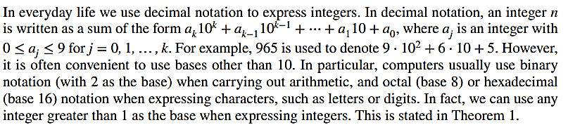
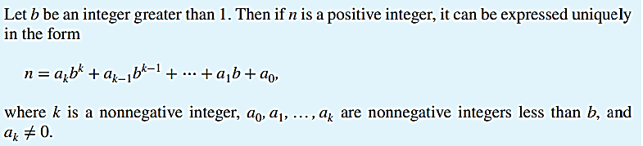
Integer Representations

Slide 13
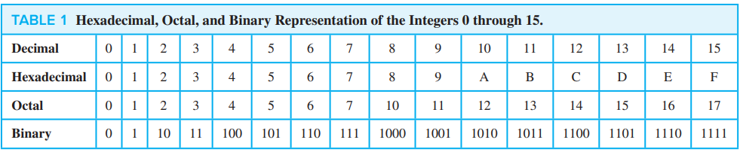

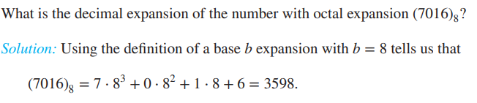
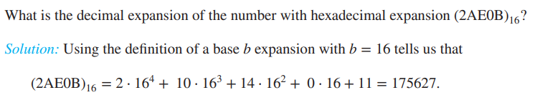
Integer Representations

Slide 14
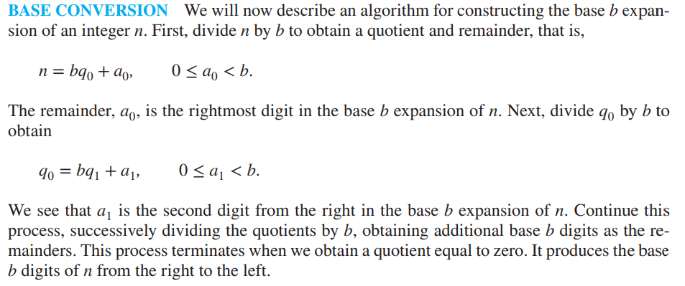
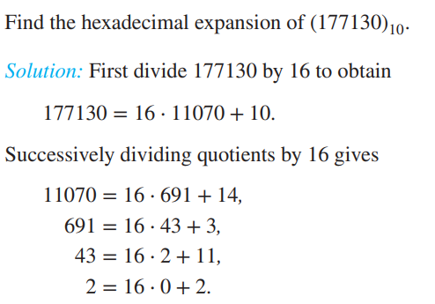
Integer Representations
The successive remainders that we have found, 10, 14, 3, 11, 2, give us the digits from the right to the left of 177130 in the hexadecimal (base 16) expansion of (177130). It follows that
(177130) 10 = (2B3EA) 16.

Slide 15
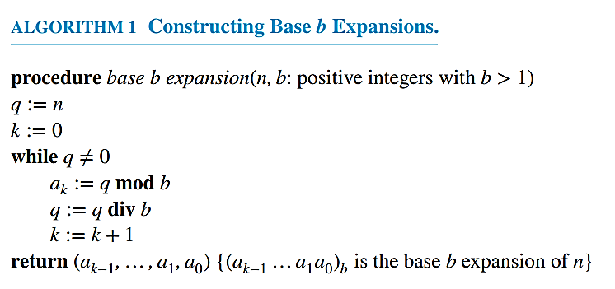
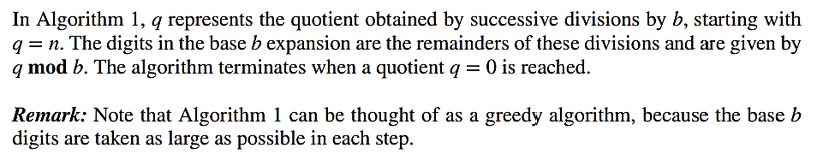
Integer Representations and Algorithms
Representations of Integers

Slide 16
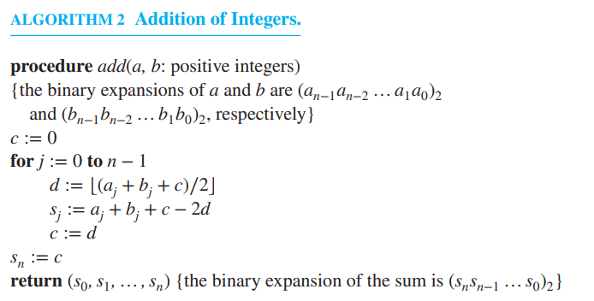
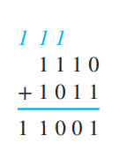
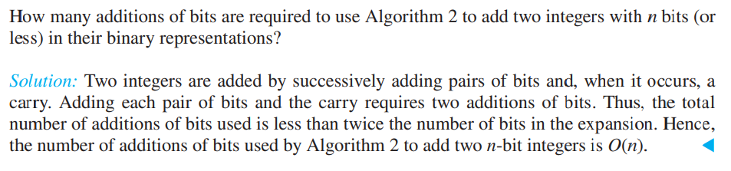
Integer Representations and Algorithms
Representations of Integers

Slide 17
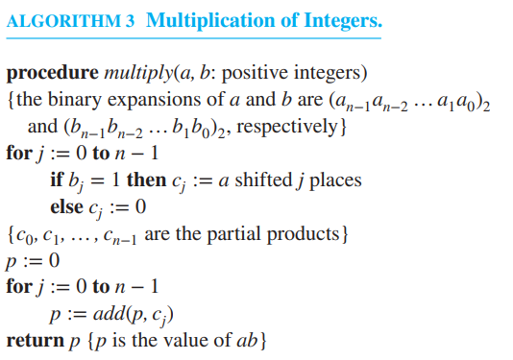
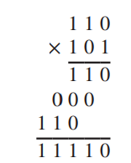
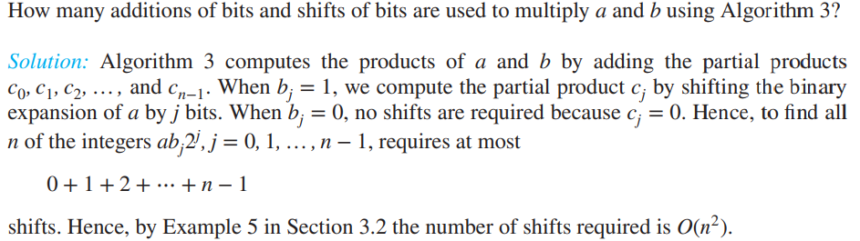

Slide 18
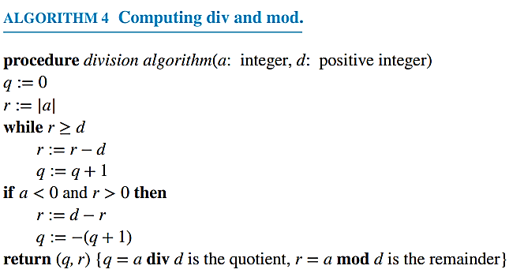
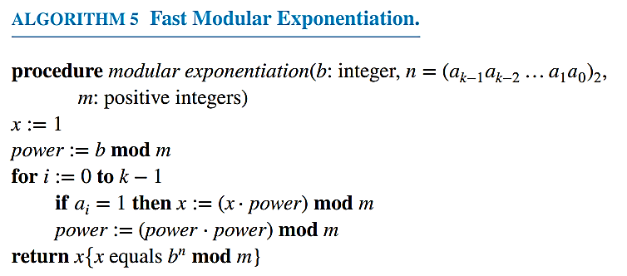

Slide 19
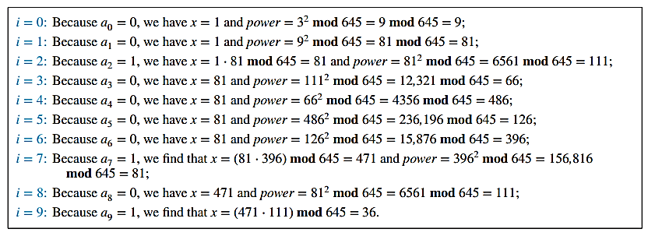
Use Algorithm 5 to find 3644 mod 645.
Solution: Algorithm 5 initially sets x = 1 and power = 3 mod 645 = 3. In the computation of 3644 mod 645, this algorithm determines 32j mod 645 for j = 1, 2, … , 9 by successively squaring and reducing modulo 645. If aj = 1 (where aj is the bit in the jth position in the binary expansion of 644, which is (1010000100)2), it multiplies the current value of x by 32j mod 645 and reduces the result modulo 645. Here are the steps used:
This shows that following the steps of Algorithm 5 produces the result 3644 mod 645 = 36.
Algorithm 5 is quite efficient; it uses O((log m) 2 log n) bit operations to find bn mod m

Slide 20
Modular Arithmetic
In some situations, we care only about the remainder of an integer when it is divided by some specified positive integer.
If a and b are integers and m is a positive integer, then a is congruent to b modulo m if m divides a − b. We use the notation a ≡ b (mod m) to indicate that a is congruent to b modulo m.
a ≡ b (mod m) is a congruence and that m is its modulus.
If a and b are not congruent modulo m, we write a ≢ b (mod m).
THEOREM 3: Let a and b be integers, and let m be a positive integer. Then a ≡ b (mod m) if and only if a mod m = b mod m.
Determine whether 17 is congruent to 5 modulo 6 and whether 24 and 14 are congruent modulo 6.
Solution: Because 6 divides 17 − 5 = 12, we see that 17 ≡ 5 (mod 6). However, because 24 − 14 = 10 is not divisible by 6, we see that 24 ≢ 14 (mod 6).

Slide 21
Modular Arithmetic
The great German mathematician Karl Friedrich Gauss developed the concept of congruences at the end of the eighteenth century. The notion of congruences has played an important role in the development of number theory.
THEOREM 4: Let m be a positive integer. The integers a and b are congruent modulo m if and only if there is an integer k such that a = b + km.
Proof: If a ≡ b (mod m), then m ∣ (a − b). This means that there is an integer k such that a − b = km, so that a = b + km. Conversely, if there is an integer k such that a = b + km, then km = a − b. Hence, m divides a − b, so that a ≡ b (mod m).
THEOREM 5: Let m be a positive integer. If a ≡ b (mod m) and c ≡ d (mod m), then a + c ≡ b + d (mod m) and ac ≡ bd (mod m).
Proof: a + c = (b+km)+(d+lm) using Theorem 4
a+c = (b+d)+(k+l)m
(a+c)-(b+d) = (k+l)m → m|(a+c)-(b+d)
→ a+c ≡ b+d (mod m)

Slide 22

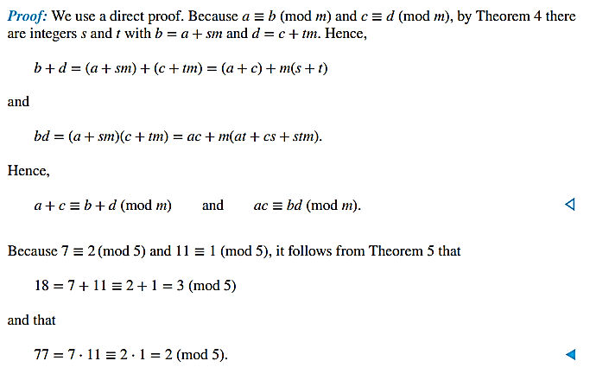
Modular Arithmetic

Slide 23
Solving Congurences
Linear congruence is of the form ax ≡ b (mod m), where m is a positive integer, a and b are integers, and x is a variable.
For solving the linear congruence, we need to find inverse of a mod m.
THEOREM: If a and m are relatively prime integers and m > 1, then an inverse of a modulo m exists.
Proof: Since gcd(a,m) = 1, there are integers s and t such that:
sa + tm = 1 (Bézout’s identity)
This implies that sa + tm ≡ 1 (mod m).
Because tm ≡ 0 (mod m), it follows that sa ≡ 1 (mod m).
Consequently, s is an inverse of a modulo m.

